Slide 1
AMAZON KINDLE STORES
REVIEWS ANALYSIS
Developed by-
Aitha Sai Priya-(18UK1AO501)
Gudikandula BharathChandra-(18UK1A0574)
Sravani Karne-(18UK1A0553)
Dongala AnjiReddy-(18UK1A0514)

Slide 2
Introduction
Amazon Kindle Store is an e-book e-commerce store for all the book reading hobbyists. Online reviews are a category of product information created by the users based on personal handling experience.
Online shopping websites endow with platforms for consumers to review products and carve up opinions.
Sentiment analysis or opinion mining is nothing but classification of emotions in the reviews text into positive, negative and neutral.
Our aim for the project to make use of Deep learning using python and extract necessary libraries from it for the sentiment analysis of the amazon kindle store reviews.

Slide 3
Deep learning
Deep learning is a field of machine learning concerned with algorithms inspired by the structure of the brain called artificial neural networks.
Each layer of its neural network builds on its previous layer with added data like a retailer, sender, user, social media event, credit score, IP address, and a host of other features that may take years to connect together if processed by a human being.
The final layer relays a signal to an analyst who may freeze the user’s account until all pending investigations are finalized.

Slide 4
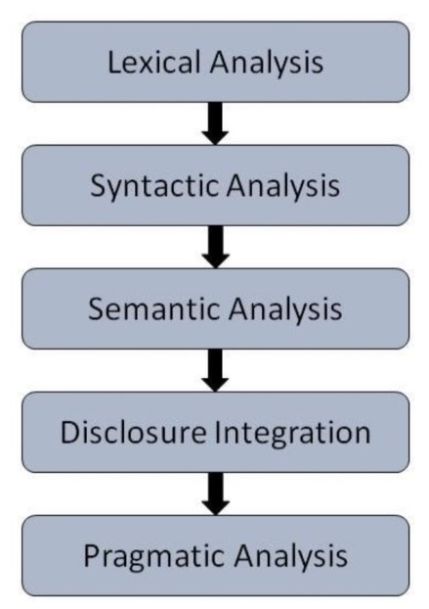
NLP (Natural Language Processing)
Natural Language Processing, usually shortened as NLP, is a branch of artificial intelligence that deals with the interaction between computers and humans using the natural language.
The ultimate objective of NLP is to read, decipher, understand, and make sense of the human languages in a manner that is valuable.
Steps in NLP:

Slide 5
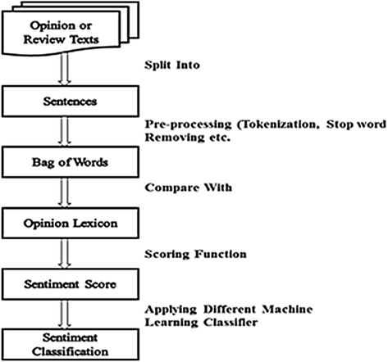
Block Diagram

Slide 6
Software Designing
Jupyter Notebook Environment
Spyder Ide
Machine Learning Algorithms
Python (pandas, numpy,keras,Tensorflow,CNN layers)
HTML
Flask
We developed this loan status prediction by using the Python language which is an interpreted and high level programming language and using the Machine Learning algorithms. For coding we used the Jupyter Notebook environment of the Anaconda distributions and the Spyder, it is an integrated scientiﬁc programming in the python language. It has scripting language to create a web page is HTML by creating the templates to use in the functions of the Flask and HTML.

Slide 7
Experimental Analysis
the dataset we used for the purpose of doing sentiment analysis is derived from https://www.kaggle.com/bharadwaj6/kindle-reviews
It contains the books names and the respective review for all the books and also the other information related to the book and also the user.
To review the comments we make use of the Natural Language Processing (NLP) algorithm it is a Deep learning algorithm which can process the sentences and remove the all punctuations and other string processing is done by this algorithm.

Slide 8
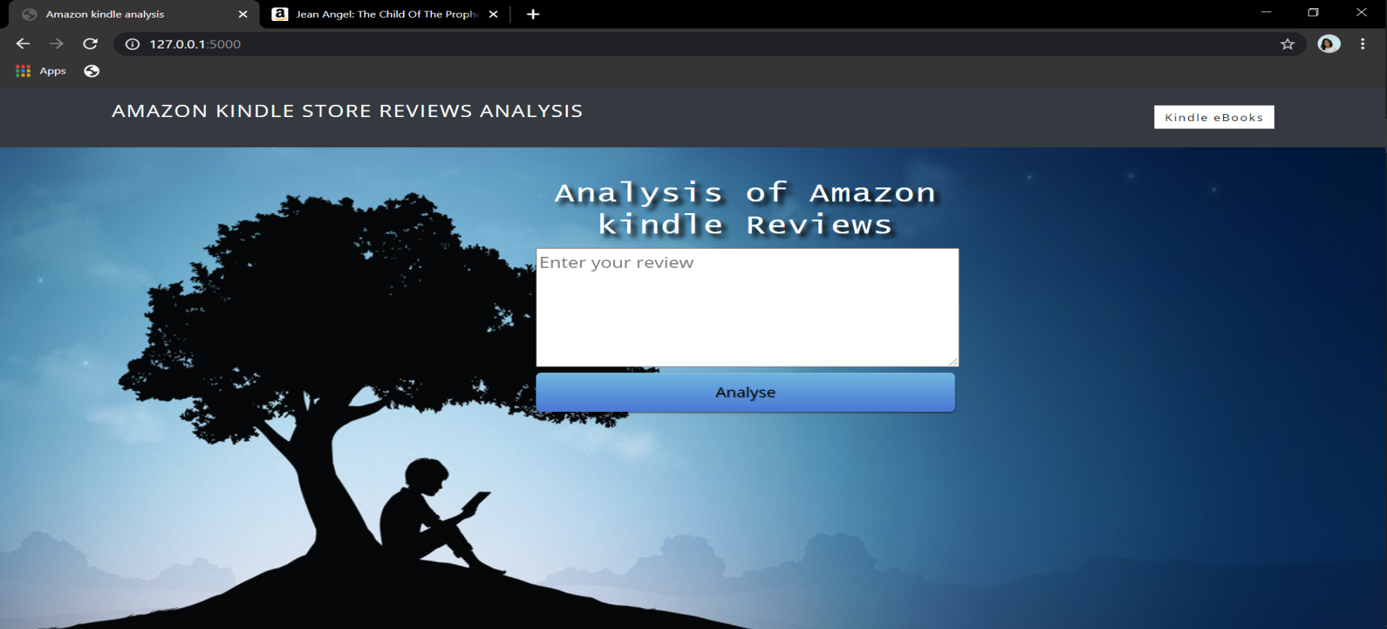
Result
The resulting model proposed by the NLP to do the sentiment analysis on the
reviews directed from the amazon kindle book store. The ouputs are generated as follows:
Home page that user enters the review

Slide 9
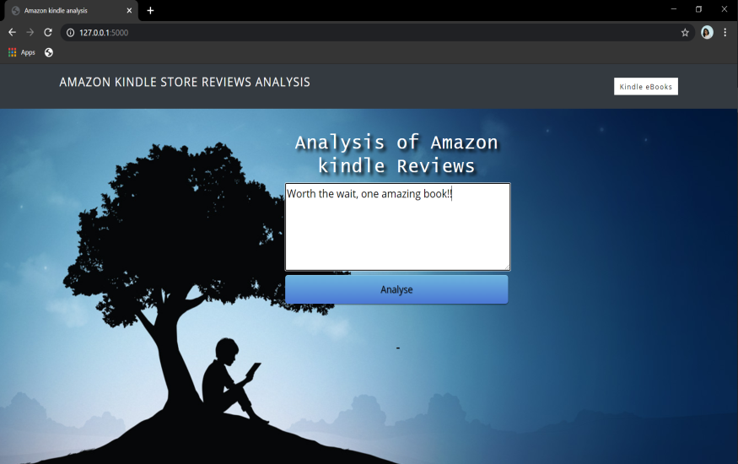
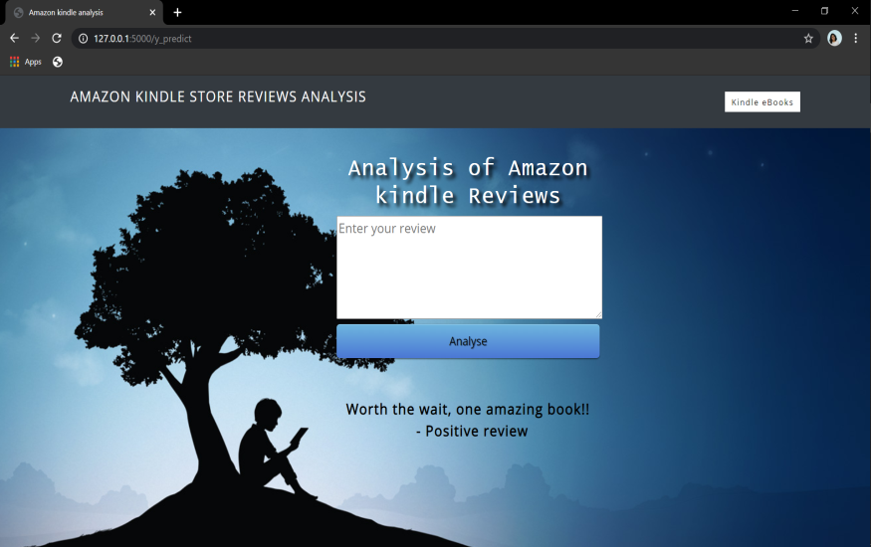


User enters the review
Displays positive review
User enters the review
Displays negative review

Slide 10
Applications
Text-based application searching that the comment is positive or negative. extracting the emotion(positive or negative) of the given sentence by the users.
Dialogue based application answering system.

Slide 11
Advantages
Users can ask comments about any book and get the direct response within seconds.
The accuracy of the answers increases with the amount of relevant information provided in the question.
Robust system in the NLP will always produce outputs, regardless of the image entered.
Disadvantages
Long time to implement and test a prototype.
Manual system creation time-consuming and expensive creation process.

Slide 12
Conclusion
It is completely impossible to use only raw text as input for making predictions. Hence, we saw that pre-processing step played a major role in the complete process of NLP.
To get better results, accuracy and make the machine take all the text as tokens, pre-processing of data is to be done carefully looking at the type of contents present in it.
The most important thing is to be able to extract the relevant features from the given source of data. This kind of data can often come as a good complementary source in order to extract more learning features and increase the predictive power of the models. And the user is able to predict that the given comment is positive or negative.

Slide 13
THANK YOU

